Slide 1
Qaoss Installation and Configuration

Slide 2
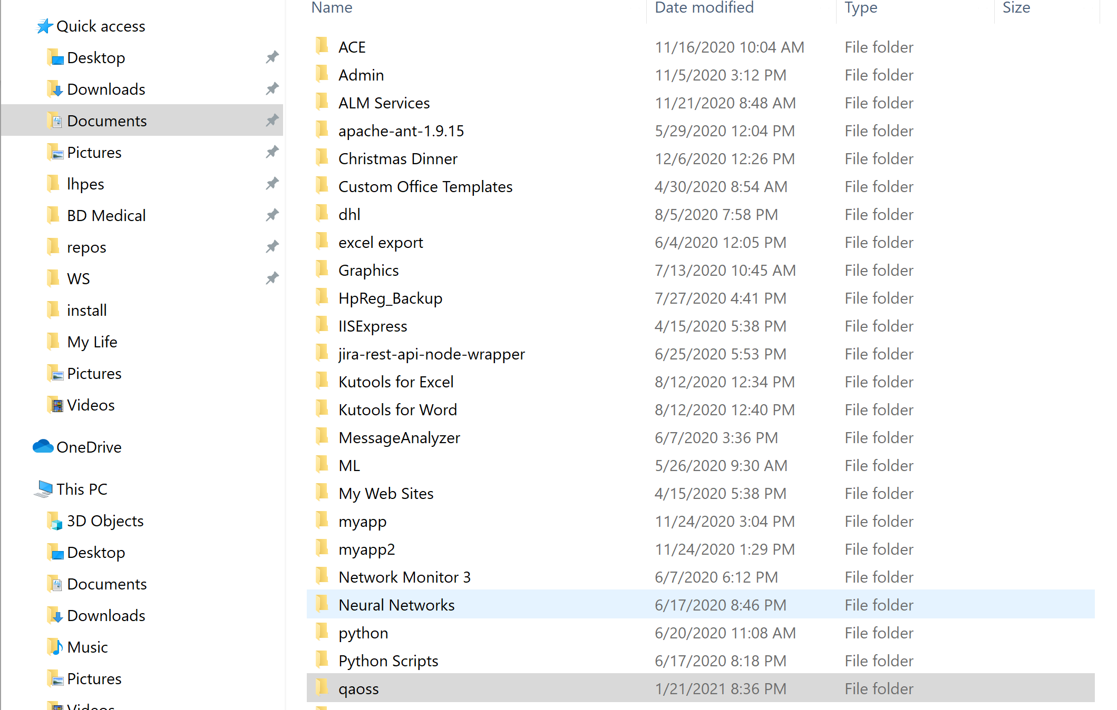
Unzip and copy the entire qaoss folder and all its contents to a folder on your local computer where you have full access. The "documents" folder works nice.

Slide 3
Download and run the node-v12.18.2-x64.msi Windows installer https://nodejs.org/en/blog/release/v12.18.2/
Accept all the default settings.

Slide 4
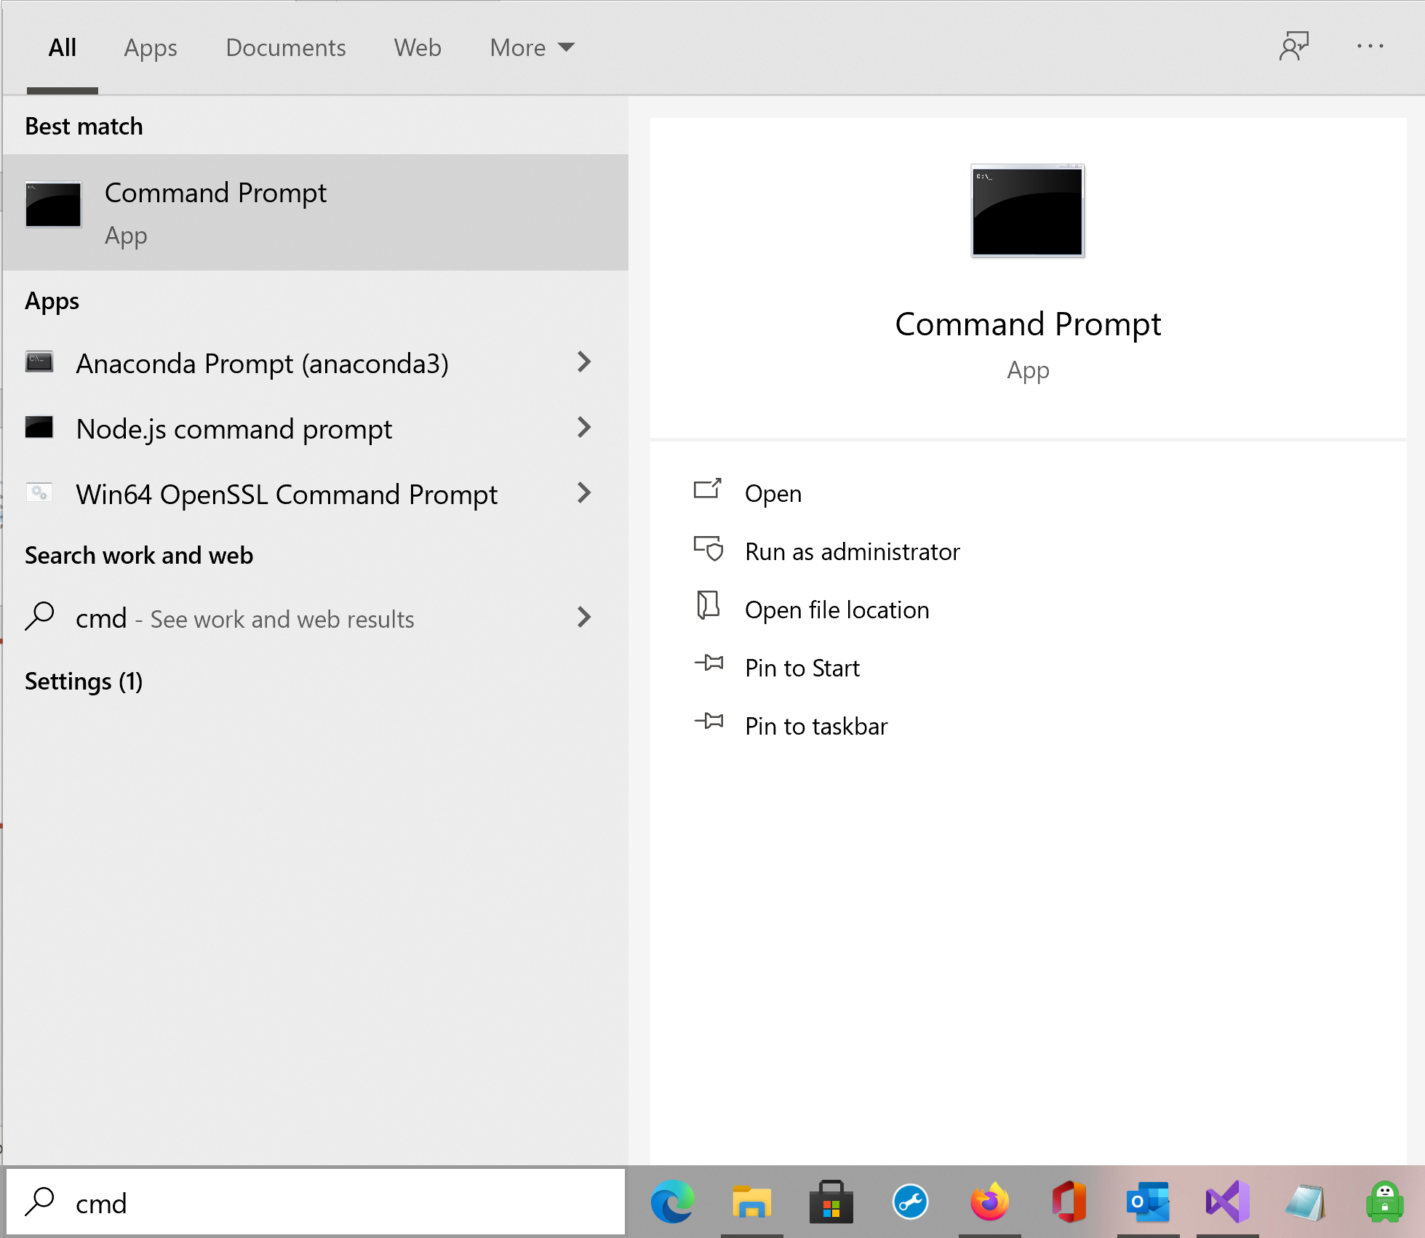
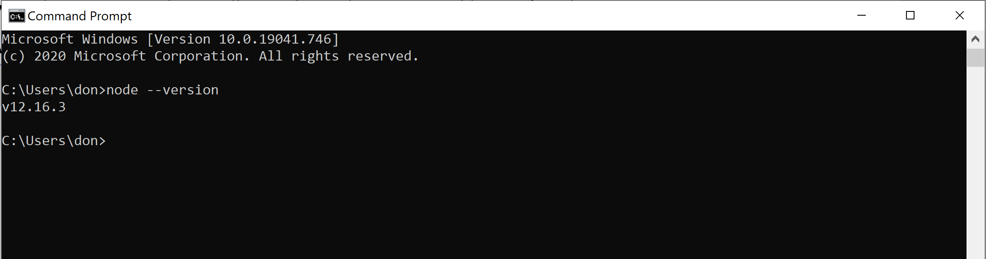
Open a dos window and test your node installation from the command line by typing: C:\node --version
It should show: v12.16.3

Slide 5
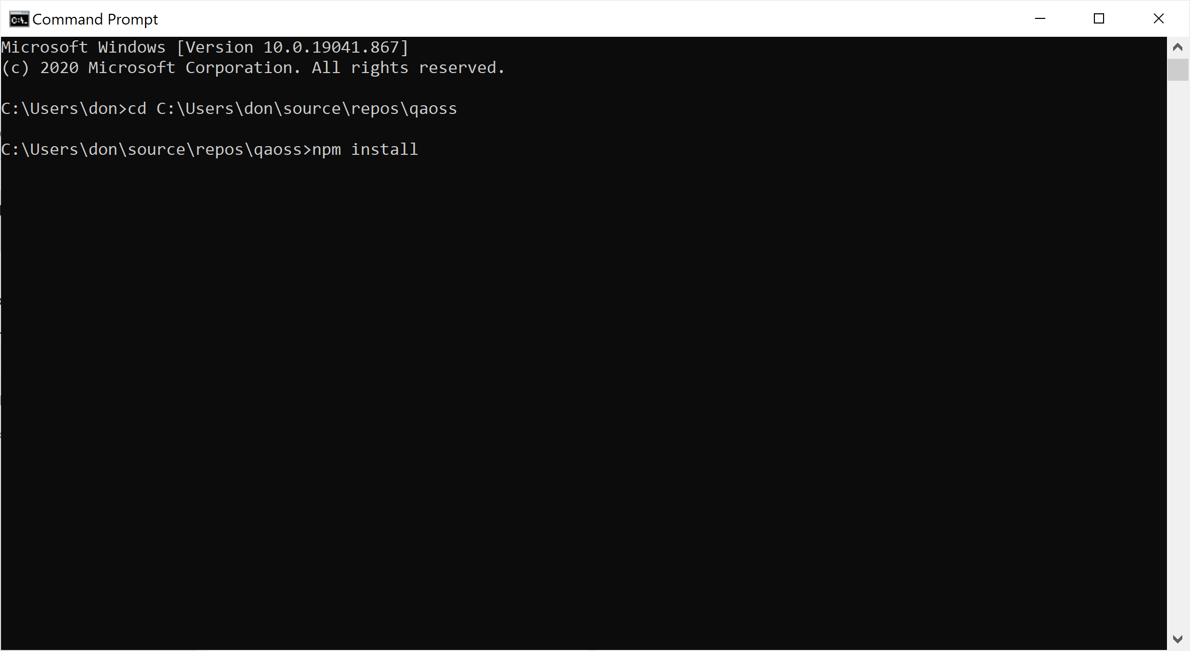
In same dos window, switch to the root qaoss folder and type the command ‘npm install’. This will install all the necessary dependencies and can take a minute or two so be patient.

Slide 6
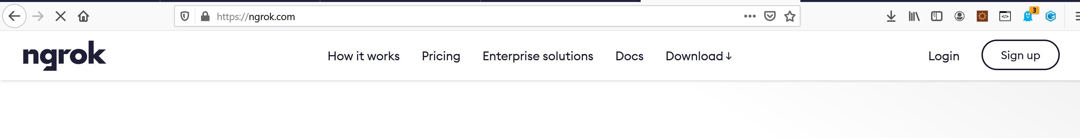
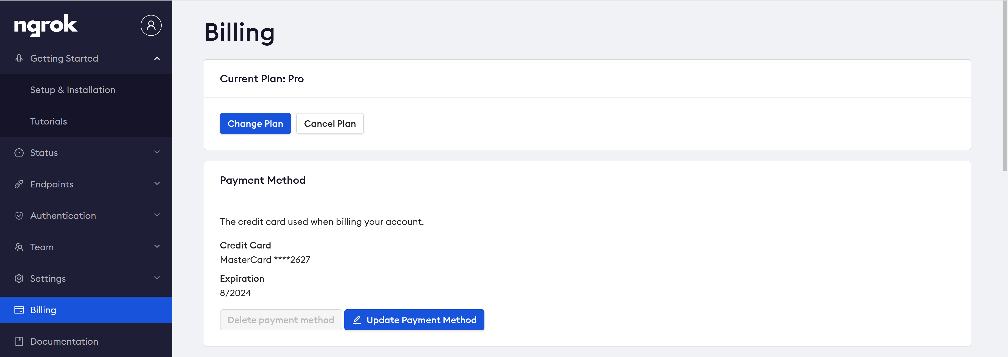
Sign up for an Ngrok account at https://dashboard.ngrok.com/signup.
Then go to the billing page.

Slide 7
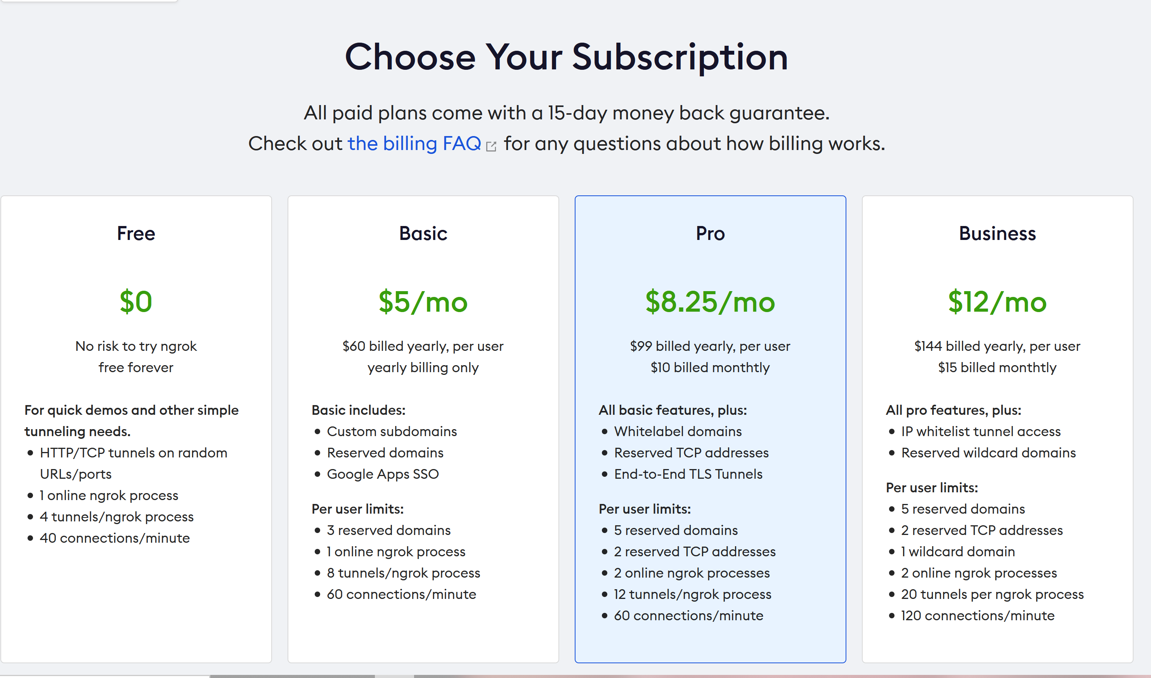
Sign up for a ‘Basic’ account. It's $5/month.

Slide 8
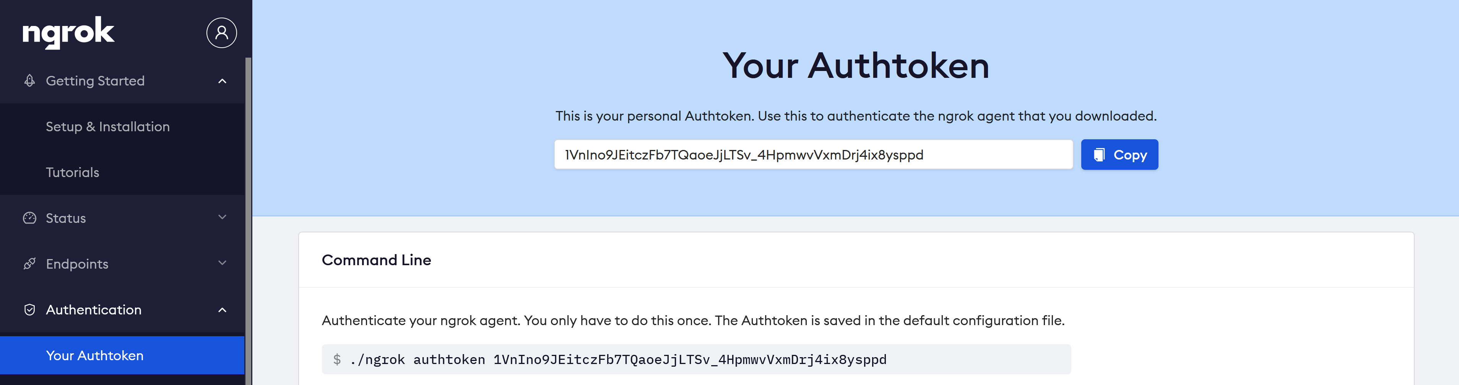
Once you're signed up Ngrok will provide you with an authentication token under the ‘Authentication/Your Authtoken’ link in the menu on the left. It’s just a long alphanumeric ID.

Slide 9
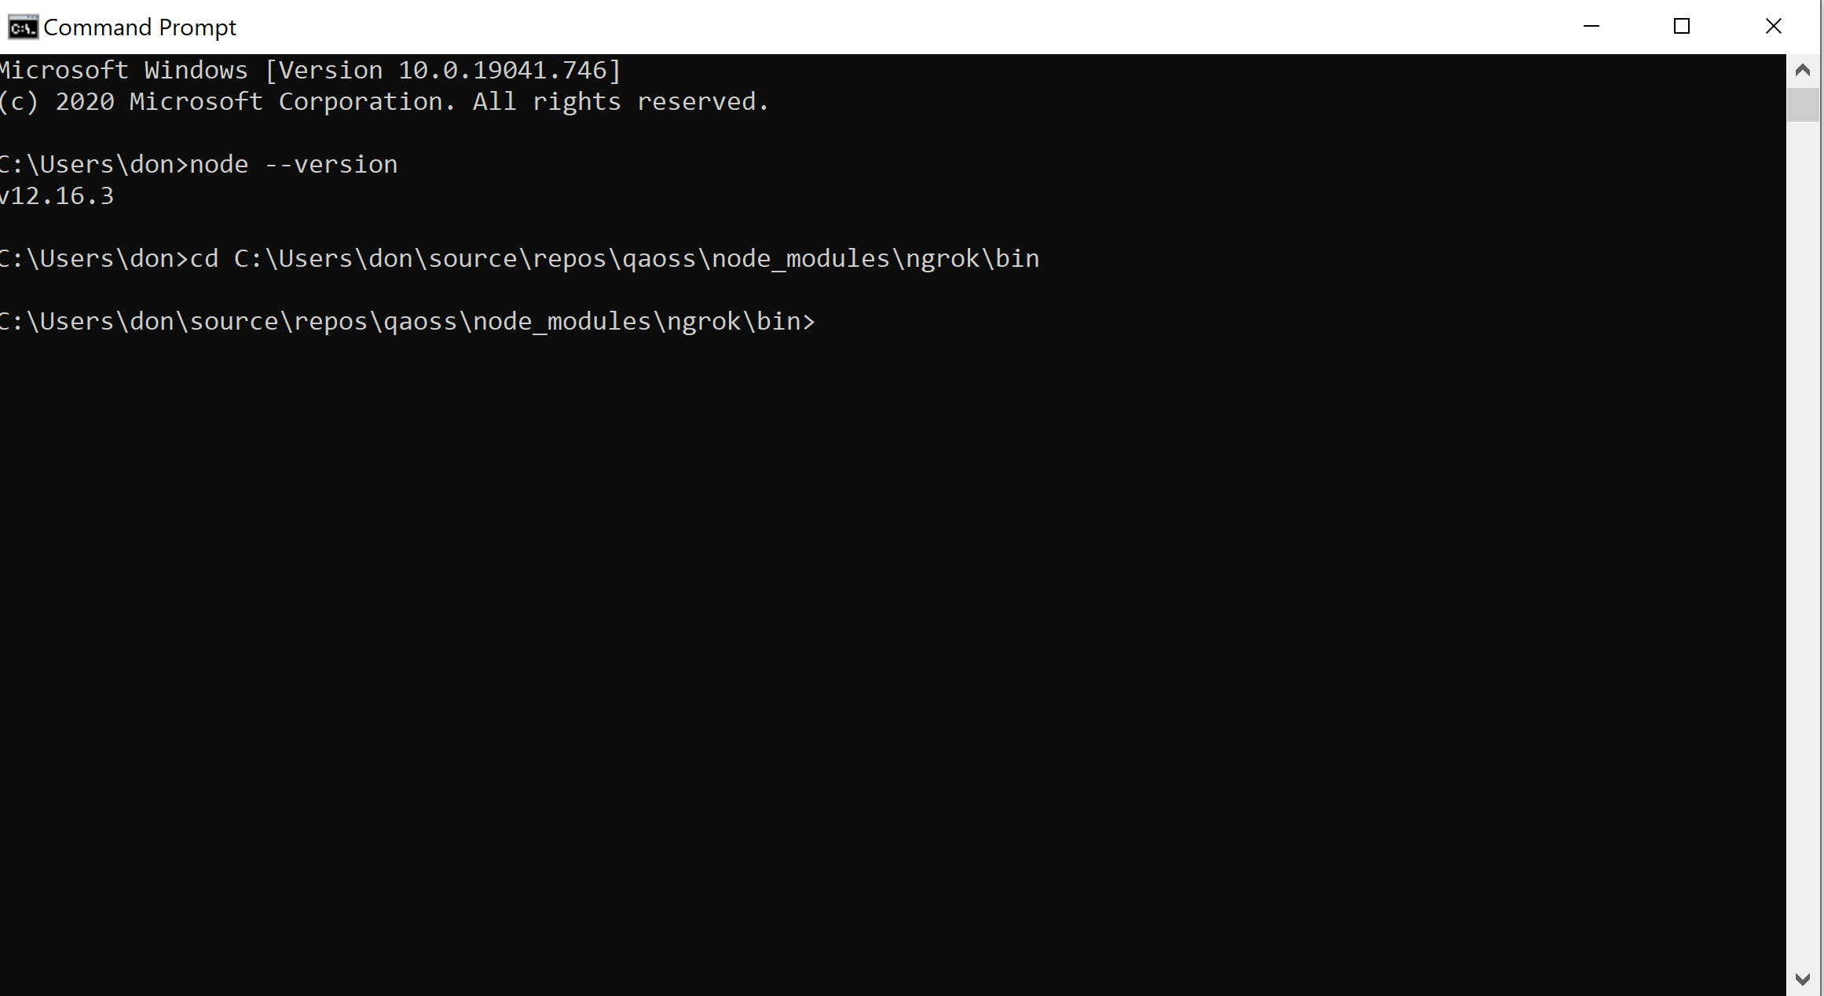
Open a dos window again and go to the “C:\(folder where you copied qaoss files)\qaoss\node_modules\ngrok\bin” folder.

Slide 10
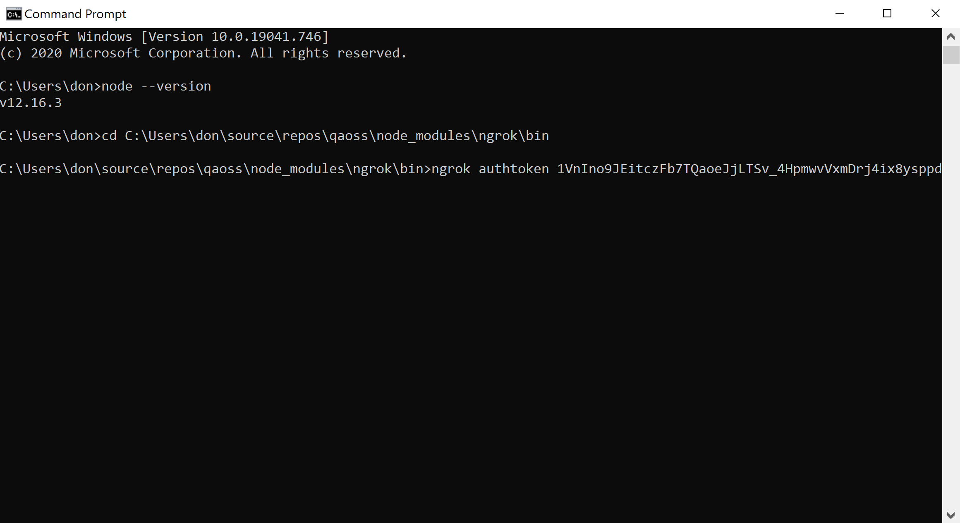
Run the following command
C:\(folder where you copied qaoss files)\qaoss\node_modules\ngrok\bin>ngrok authtoken (your authentication token here)
You should see the message: Authtoken saved to configuration file: ngrok.yml

Slide 11
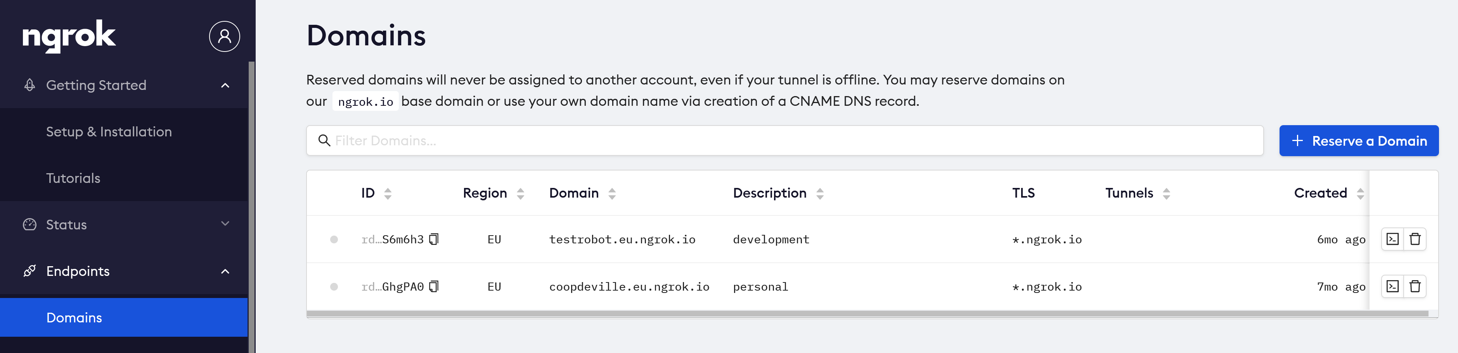
Log into your account at ngrok and go to "endpoints" --> "domains" and create a custom domain for yourself.
Eg; "RockAndRoll" or anything you want.
You can create two domains if you’d like. Use one for a personal Qaoss timeline and one for a Group timeline.

Slide 12
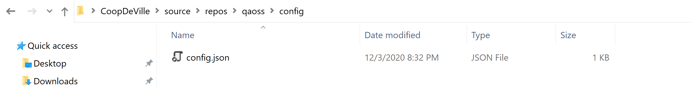
On your computer in the config folder under the qaoss folder right click and open the config.json with a text editor like Notepad. Then add your new custom domain name to the “ngrok_url” parameter and pick an alias for your timeline. Make sure they are in double quotes.
{
"port": "3000",
"group": "0“,
"ngrok_url": “RockAndRoll”, ←Make sure it’s in double quotes
"alias":“Elvis“
}

Slide 13
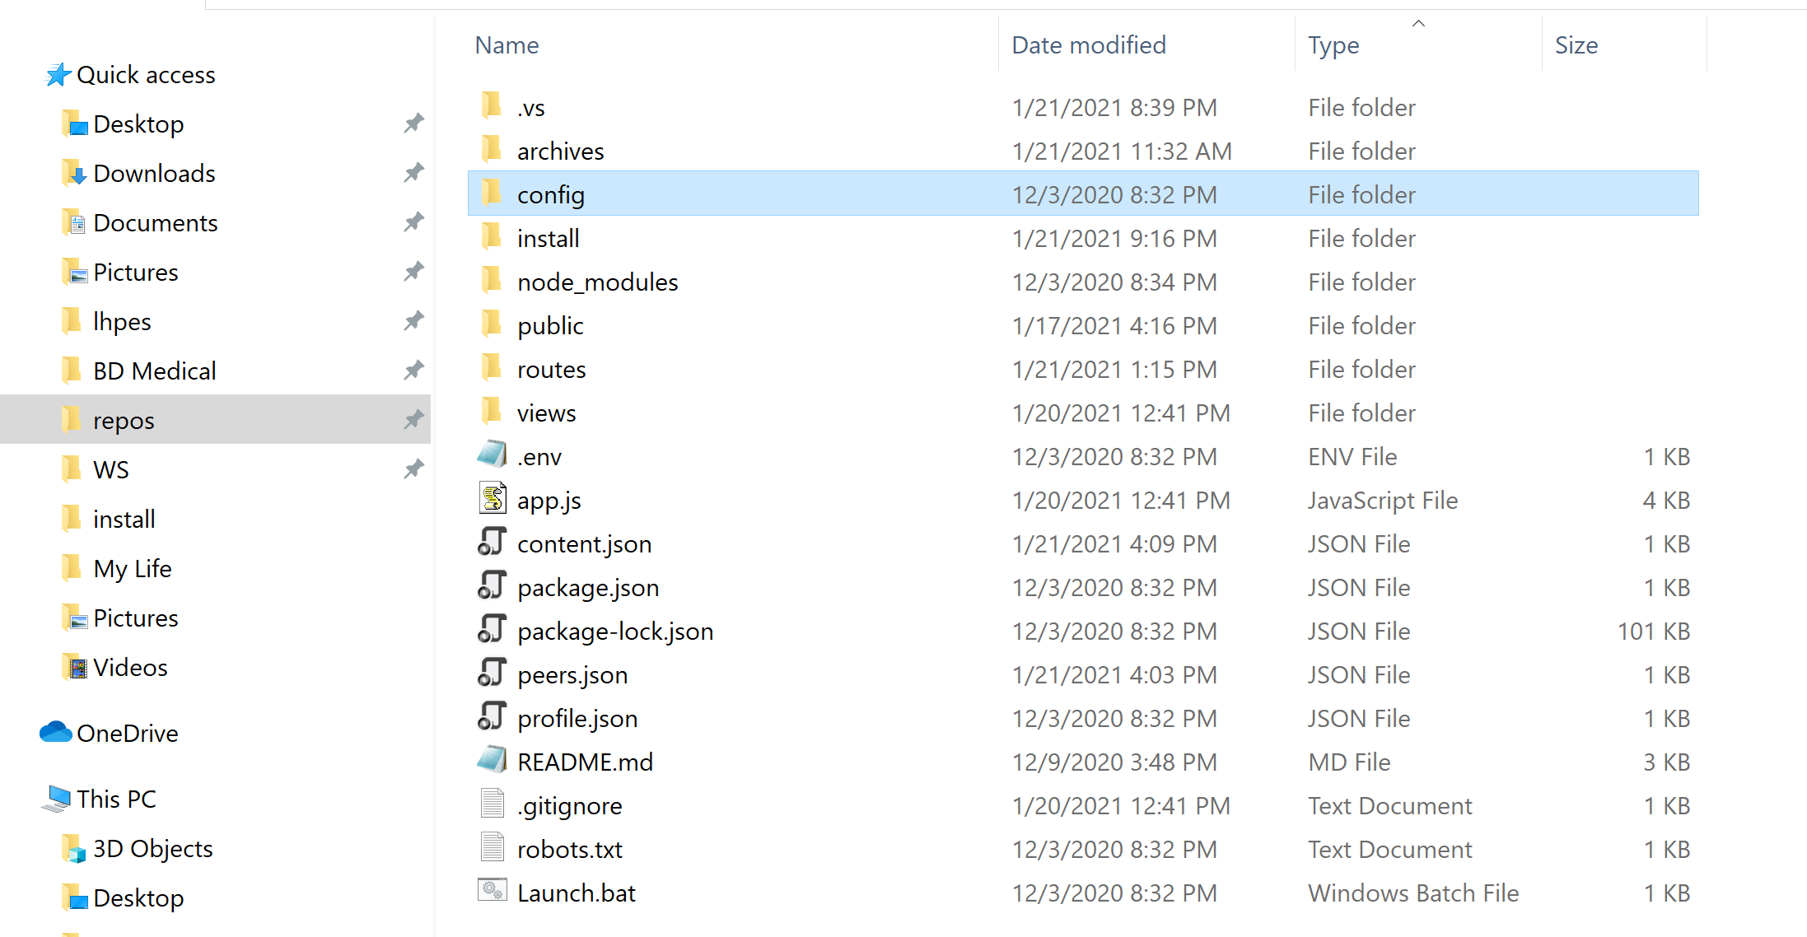
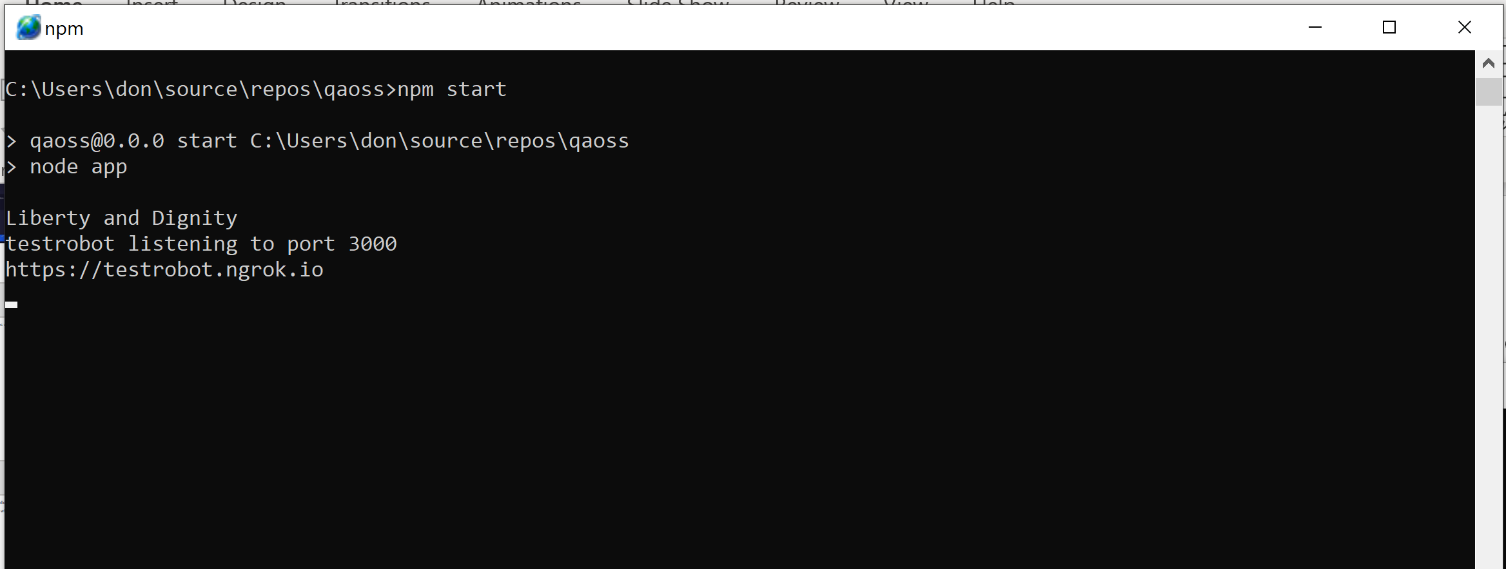
Double click the Launch.bat file in the qaoss folder. Your personal social media website should be up and running.

Slide 14
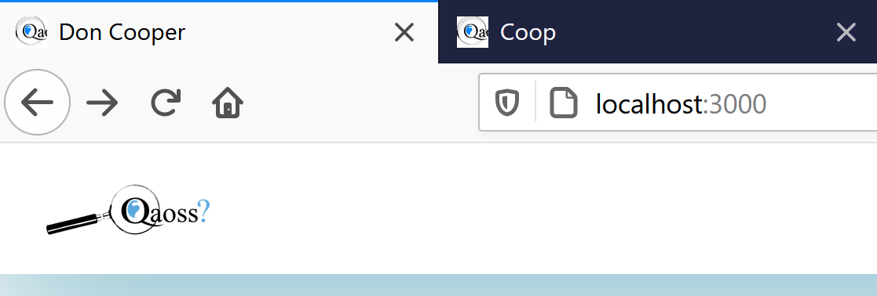
Open a browser – Firefox, Edge or Chrome -- and type localhost:3000 in the address bar to begin testing.

Slide 15
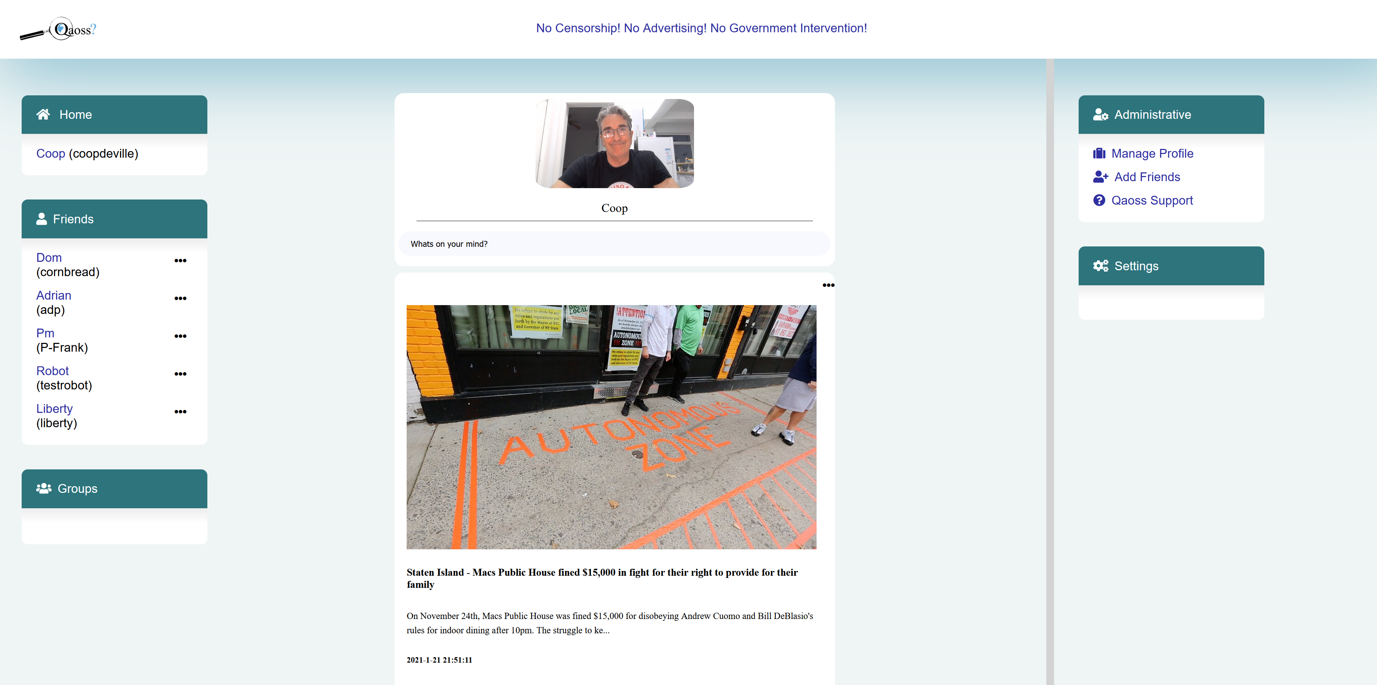

Slide 16
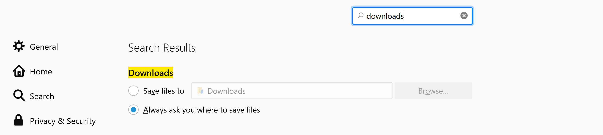
Go to your browsers “Settings” and configure “Downloads” to ask where to save each time.
Consult your browsers help to find out how to configure download settings. This is needed for sharing posts from other users. Since all your content is saved on your computer, you save shared posts on your computer as well.

